Slide 1
Day 1: Foundations of Software Engineering

Slide 2
01
Introduction to Software Engineering

Slide 3
Programming vs Engineering
If you were asked to build an app in 2 days for fun, vs. a banking system for millions, what changes?
How do companies bring a product to a user?

Slide 4
Programming vs Engineering
Mindset & Goal
Aspect | Personal Project | Banking System
Purpose | Explore an idea, learn | Handle real money and people’s trust
Success metric | “It runs and looks cool!” | “It’s secure, reliable, compliant, and scalable.”
Time horizon | Disposable prototype | Long-term maintenance and evolution
Architecture & Design
Architecture | Simple monolith; minimal layers | Modular microservices or layered architecture
Data | “Good enough for a few users” | Horizontally scalable with load balancing, replication, and redundancy

Slide 5
Programming vs Engineering
Architecture & Design
Extensibility | “We’ll rewrite it later” | Designed for future integration, APIs, and compliance updates
Security & Compliance
Testing for exploits | None or minimal | Full security audits, penetration testing, continuous monitoring
Development Process
Team | One or two devs hacking | Dozens of engineers, QA, compliance officers, DevOps
Testing | Manual “click around” | Unit, integration, regression, performance, and UAT testing
Deployment | Push to production once | Staged environments (dev → QA → staging → prod)

Slide 6
Programming vs Engineering
User Experience
Ethics, Regulation & Accountability
Conclude: That’s the shift from programming → engineering

Slide 7
Definition of Software Engineering
IEEE Definition: “Software Engineering is the application of a systematic, disciplined, quantifiable approach to the development, operation, and maintenance of software.”
key principles:
Systematic → structured process
Disciplined → follows rules/methodologies
Quantifiable → measurable results
Maintenance → not just coding, but evolution

Slide 8
Why is SE important?
Poor planning ---------------------------------> Delays & costs
No documentation --------------------------> difficult maintenance
No testing ---------------------------------------> bugs
Lack of user focus ----------------------------> product failure
Case Studies:
Ariane 5 rocket failure (1996): Software error → $370M loss.
Healthcare system bug: Incorrect dosage → patient harm.

Slide 9
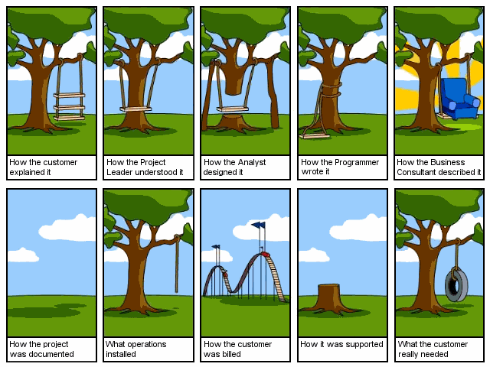
Deliver what the customer really needs

Slide 10
“Software engineering is not about writing code faster—it’s about building software that lasts.”

Slide 11
What makes software hard?
“Think of an app you use daily — what makes it hard to build or maintain?”
🧩 Key Challenges in Modern Software Engineering
Challenge | Category | Example
Systems today are large and interconnected. | Increasing Complexity | E-commerce with payment, delivery, AI, and Health systems
User needs and business goals evolve quickly. | Rapidly Changing Requirements | Instpay monthly required services

Slide 12
What makes software hard?
Protecting data and systems against cyber threats. | Security & Privacy | Leaking user data: Fawry issue
Systems must handle millions of users or transactions. | Scalability & Performance | Netflix or Amazon is handling global traffic.
Limited resources, tight deadlines. | Time and Cost Constraints | Balancing features, speed, and quality.
Most of a system’s life is spent in maintenance. | Maintenance & Evolution
Distributed teams and communication gaps. | Team Collaboration | Online work, Different time zones, tools, and languages.
Tools, frameworks, and platforms evolve rapidly. | Technological Change
Ensuring fairness, accessibility, and sustainability. | Ethical & Social Responsibility | Facebook and US elections

Slide 13
Why This Means “Software Engineering” Is Like a Science / Engineering Discipline
Predictability & Repeatability: SE uses scientific techniques to make software development more predictable (e.g., metrics, modeling, testing).
Trade-off Analysis: Engineers must constantly balance trade-offs (speed vs quality, security vs usability, short-term vs long-term cost) — which requires systematic thinking.
Empirical Methods: Research in SE (architecture, maintainability, quality) relies on experiments, controlled studies, and measurement.
Design Principles: Principles like separation of concerns or modularity come from scientific design thinking.
Management Science: Planning, estimation, resource allocation, and risk management are all engineering-management problems — not just coding.

Slide 14
02
Software Development Life Cycle (SDLC)

Slide 15
Introduction to SDLC
The Software Development Life Cycle (SDLC) : It is a structured process that defines the steps involved in developing, delivering, and maintaining high-quality software
Purpose
Provides a systematic approach to software development.
Ensures quality, predictability, and control across the project lifecycle.

Slide 16
SDLC cycle
Requriments
Design
01
02
Understand what the customer or user needs.
Translate requirements into a technical blueprint
Testing
Developing
06
03
Ensure the software meets requirements and is defect-free
Convert the design into executable code
05
Deployment
Maintance
04
Ensure the continued usability and performance of the software.
Make the system available to users.
This template has been created by Slidesgo

Slide 17
🌀 SDLC Phases Explained
1. Requirements Phase (What to build?)
Requriments
Goal: Understand what the customer or user needs.
Activities:
Gather requirements through interviews, surveys, and observation.
Define functional (what the system should do) and non-functional
(performance, usability, security) requirements.
Create a Software Requirements Specification (SRS) document.
Deliverable: Approved requirements document.

Slide 18
🌀 SDLC Phases Explained
2. Design Phase (How to build it?)
Design
Goal: Translate requirements into a technical blueprint.
Activities:
Design system architecture (modules, databases, interfaces).
Create UML diagrams — class, sequence, use case diagrams, etc.
Decide on technologies and design patterns.
Deliverable: Design Document (System & Detailed Design).

Slide 19
🌀 SDLC Phases Explained
3. Implementation / Coding Phase (Build it!)
Developing
Goal: Convert the design into executable code.
Activities:
Developers write, integrate, and document code.
Follow coding standards and version control (Git).
Deliverable: Working software modules.

Slide 20
🌀 SDLC Phases Explained
4. Testing Phase (Does it work correctly?)
Testing
Goal: Ensure the software meets requirements and is defect-free.
Activities:
Unit, Integration, System, and User Acceptance Testing (UAT)
Use automated testing tools and bug tracking systems.
Deliverable: Tested software and test reports.

Slide 21
🌀 SDLC Phases Explained
Deployment
5. Deployment Phase (Deliver it!)
Goal: Make the system available to users.
Activities:
Deploy to production servers or app stores
Provide training or user manuals.
Monitor for any post-release issues.
Deliverable: Tested software and test reports.

Slide 22
🌀 SDLC Phases Explained
6. Maintenance Phase (Keep it running and improving)
Maintance
Goal: Ensure continued usability and performance of the software.
Activities:
Fix bugs, optimize performance, add new features
Adapt to new hardware, OS updates, or business changes.
Deliverable: Updated and stable software.

Slide 23
🌀 SDLC
Case Study: Library management system

Slide 24
03
Software Process Models

Slide 25
Introduction to Software Process Models
What is a Software Process Model?
Process Model is a structured framework that defines How SDLC phases are organized and executed to build software.
Analogy:
Think of SDLC as the recipe ingredients, and the process model as the cooking style — the order and method in which you use those ingredients.

Slide 26
🚀 Major Software Process Models
1️⃣ Waterfall Model
Concept: Sequential, one phase after another (like a waterfall).
Phases: Requirements → Design → Implementation → Testing → Deployment → Maintenance
Features:
Easy to understand and manage.
Rigid: No going back to previous phases easily.
Works best when requirements are clear and stable.
Use Case: Banking systems, government, or defense projects.

Slide 27
🚀 Major Software Process Models
1️⃣ Waterfall Model
Advantage vs Disadvantage?
What type of projects?

Slide 28
🚀 Major Software Process Models
2️⃣ V Model
Concept: extends the Waterfall model by directly mapping development phases to corresponding testing phases.
Phases: On the left side of the “V” you have verification phases (requirements → system design → architecture → module design → coding)
and on the right side, you have validation/testing phases (unit tests → integration tests → system tests → acceptance tests)
Features:
emphasizes early test planning
Rigid: No going back to previous phases easily.
Works best when requirements are clear and stable.

Slide 29
🚀 Major Software Process Models
3️⃣ Iterative Model
Concept: Build the system in successive versions — each iteration improves on the previous one.
Each cycle includes planning, design, implementation, and testing of a subset of features.
Features:
Feedback-driven; allows gradual improvement.
Easier to manage risk than the Waterfall.
Early partial versions available for review.
Use Case: Medium-sized applications where requirements evolve slowly.

Slide 30
🚀 Major Software Process Models
3️⃣ Iterative Model
Typical iteration structure?
What type of projects?
When not to use it?
Tips

Slide 31
🚀 Major Software Process Models
4️⃣ Incremental Model
Concept: The system is developed and delivered in increments (small functional parts).
Each increment adds a working portion of the system.
Each cycle includes planning, design, implementation, and testing of a subset of features.
Features:
Early delivery of usable software.
Easier testing and risk management.
Customer feedback at each stage.
Use Case: Web or mobile apps, where early versions can go live with basic features

Slide 32
🚀 Major Software Process Models
4️⃣ Incremental Model
Advantage vs Disadvantage?
What type of projects?
Increment vs iterative?

Slide 33
🚀 Major Software Process Models
5️⃣ Agile Model
Concept: Develop software in short, iterative cycles (sprints) with constant user collaboration. )Increment + Iterative)
Features:
Emphasizes adaptability, customer feedback, and team collaboration.
Working software delivered every few weeks.
Use Case: Startups, mobile apps, dynamic web apps.

Slide 34
🚀 Major Software Process Models
5️⃣ Agile Model
Characteristics?
What type of projects?
Why and Why Not?

Slide 35
🚀 Major Software Process Models
6️⃣ DevOps Model
Concept: Extends Agile by integrating development and operations — continuous delivery and deployment.
Features:
Automation of testing, integration, and deployment (CI/CD).
Continuous monitoring and feedback.
Focus on speed and reliability.
Use Case: Startups, mobile apps, dynamic web apps.

Slide 36
Agile in Action
04

Slide 37
Agile in Action
Agile focuses on iterative delivery, customer feedback, and adaptability
“You don’t need a big plan, you need a flexible one.”
Customer collaboration over contract negotiation.
Responding to change over following a plan.
Working software over comprehensive documentation.
Example: A startup building a food delivery app — customers keep changing their preferences (add online payment, track delivery, etc.). Agile helps the team adapt fast.

Slide 38
Agile Workflow Overview
Backlog → Sprint Planning → Development → Testing → Review → Deployment → Feedback → Next Sprint
Understanding User Stories
Format:
As a [user], I want [feature] so that [benefit].
Example:
As a customer, I want to track my order so that I know when my food will arrive.
Add acceptance criteria below:
User sees live delivery updates
Map refreshes every 10 seconds

Slide 39
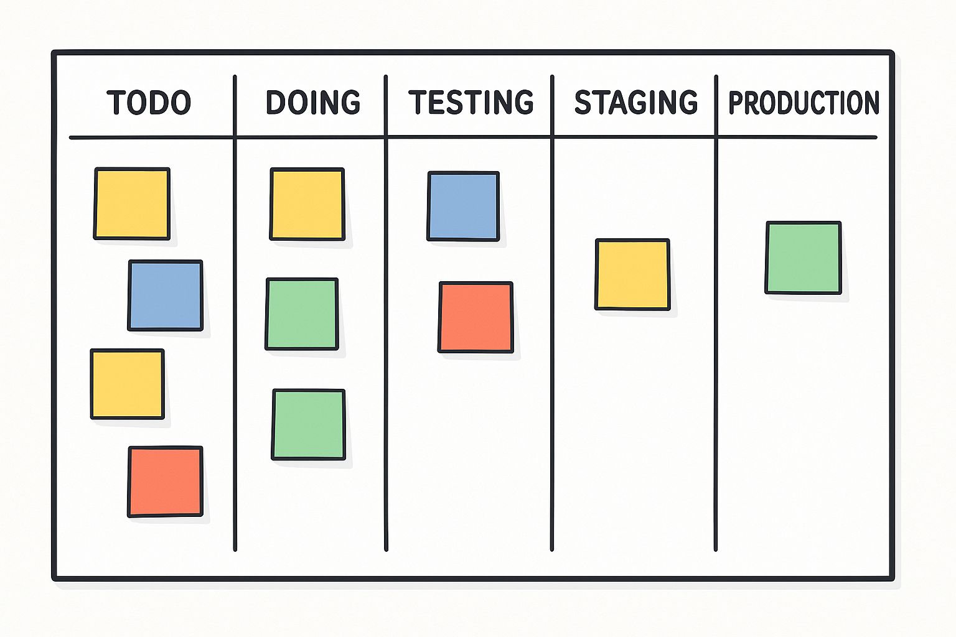
Agile Workflow Overview

Slide 40
Sprint Execution
Teams pick tasks from To Do → In Progress → Testing → Done.
Emphasize:
Daily stand-up (15 min)
Code reviewed before moving to “Testing”
Agile Testing & Deployment
Testing happens within the sprint (not after all development).
Continuous Integration (CI) and Continuous Deployment (CD) — each increment is potentially deployable.

Slide 41
Sprint Review & Retrospective
Review: show progress to the Product Owner.
Retrospective: team reflects — what went well, what to improve.
Example questions:
What slowed us down? What helped us deliver faster?

Slide 42
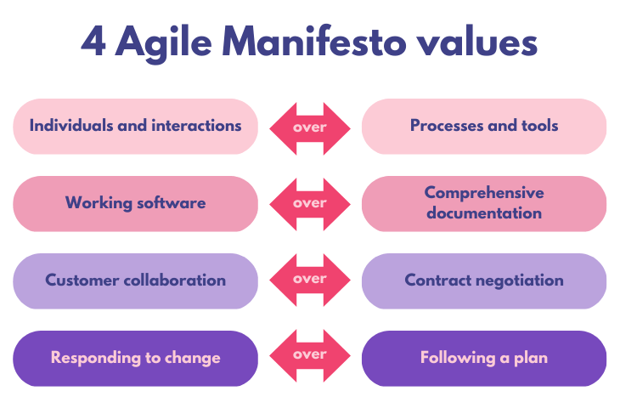

Slide 43
The 4 Agile Values (Agile Manifesto)
Agile Manifesto defines how teams should approach software development — emphasizing people, collaboration, and adaptability over rigid processes.
Individuals and Interactions over Processes and Tools:
“We value individuals and interactions over processes and tools.”
Meaning: People build software, not tools.
Effective teamwork, communication, and collaboration matter more than strict adherence to procedures or software tools.
Example: Agile teams hold daily stand-up meetings to discuss progress and blockers.

Slide 44
The 4 Agile Values (Agile Manifesto)
2. Working Software over Comprehensive Documentation:
“We value working software over comprehensive documentation.”
Meaning: Delivering a working product is more valuable than spending too much time on paperwork.
Documentation is still important — but it shouldn’t delay delivering usable software.\
Example: A functional prototype or MVP shown to the client provides more value than a 100-page specification document.

Slide 45
The 4 Agile Values (Agile Manifesto)
3. Customer Collaboration over Contract Negotiation
“We value customer collaboration over contract negotiation.”
Meaning: Agile teams work with the customer, not just for the customer. Frequent feedback ensures the final product truly meets the customer’s needs, even if those needs change.
Example: The customer participates in sprint reviews and helps prioritize features, instead of waiting until the end to evaluate the system.

Slide 46
The 4 Agile Values (Agile Manifesto)
4. Responding to Change over Following a Plan:
“We value responding to change over following a plan.”
Meaning: Plans are useful, but flexibility is more important.
Agile teams adjust their plans as requirements evolve or new challenges appear.
Example: If market trends shift, the team can re-prioritize the product backlog to add new features quickly.

Slide 47
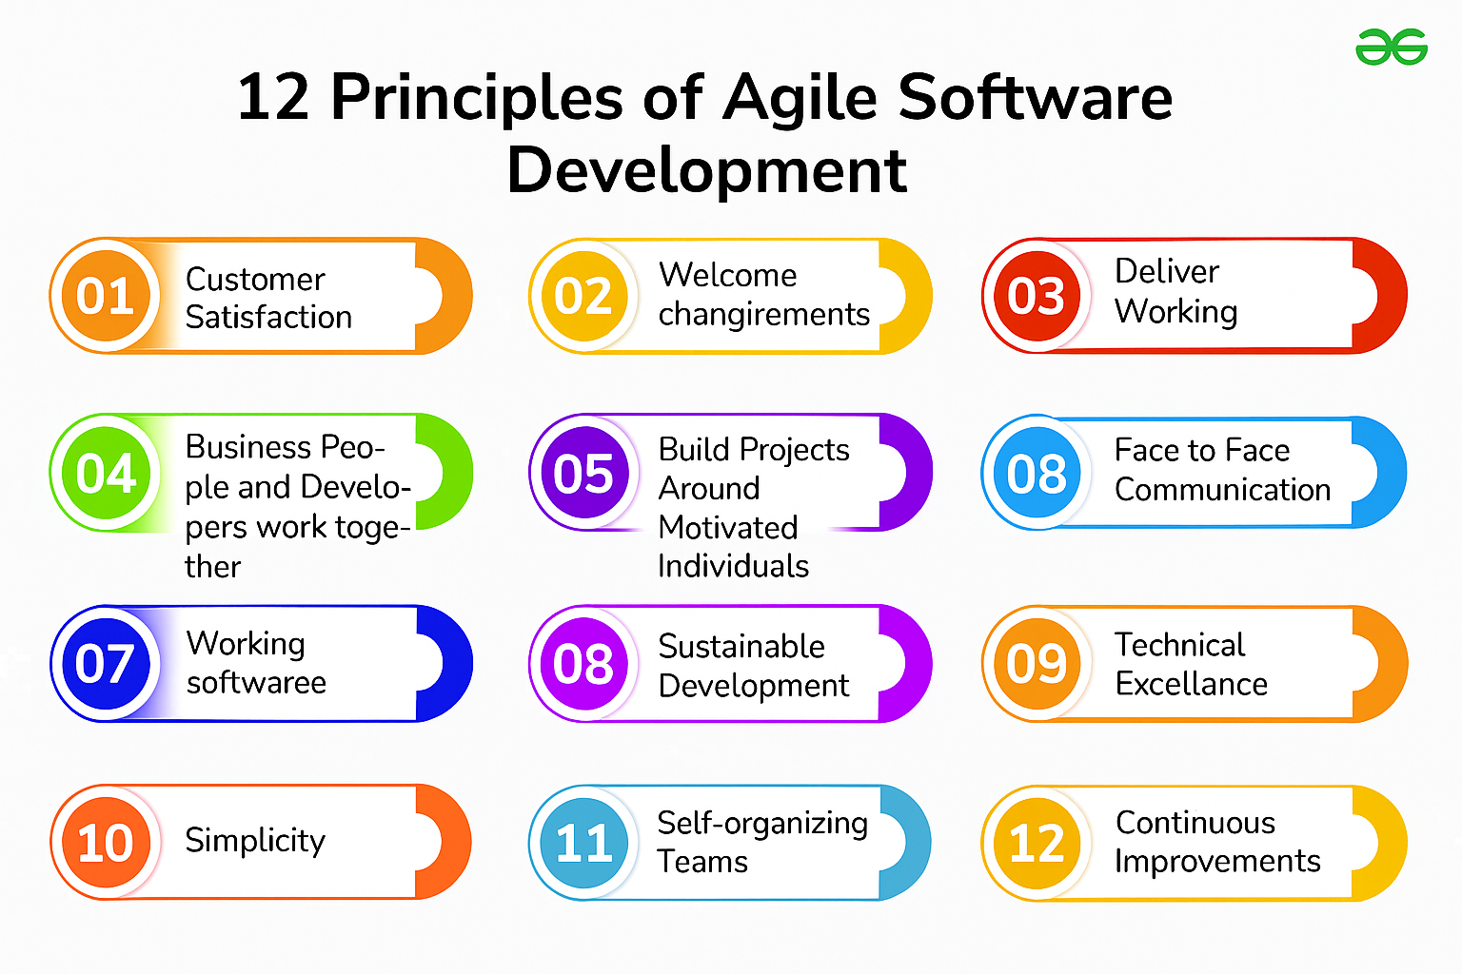

Slide 48
⚡ The 12 Principles of Agile Software Development
1. Customer Satisfaction
“Our highest priority is to satisfy the customer through early and continuous delivery of valuable software.” Deliver working software frequently so customers see progress and give feedback early.
2. Welcome Changing Requirements
“Welcome changing requirements, even late in development.” Agile teams embrace change — flexibility leads to better alignment with business needs.

Slide 49
⚡ The 12 Principles of Agile Software Development
3. Deliver Working Software Frequently
“Deliver working software frequently, from a couple of weeks to a couple of months.”
Short iterations (sprints) keep momentum and enable early testing and adaptation.
4. Business People and Developers Work Together
“Business people and developers must work together daily throughout the project.”
Continuous collaboration ensures the product fits real business goals.

Slide 50
⚡ The 12 Principles of Agile Software Development
5. Build Projects Around Motivated Individuals
“Give them the environment and support they need, and trust them to get the job done.”
Empowered, self-organizing teams are the heart of Agile success.
6. Face-to-Face Conversation
“The most efficient and effective method of conveying information is face-to-face conversation.”
Direct communication (meetings, stand-ups, video calls) reduces misunderstanding.

Slide 51
⚡ The 12 Principles of Agile Software Development
7. Working Software is the Primary Measure of Progress
“Working software is the primary measure of progress.”
Delivering real, usable functionality matters more than documents or plans.
8. Sustainable Development
“Agile processes promote sustainable development. The sponsors, developers, and users should be able to maintain a constant pace indefinitely.”
Teams should avoid burnout — consistent delivery matters more than speed spikes.

Slide 52
⚡ The 12 Principles of Agile Software Development
9. Continuous Attention to Technical Excellence
“Continuous attention to technical excellence and good design enhances agility.” Clean code, refactoring, and good design make change easier and faster.
10. Simplicity
“Simplicity — the art of maximizing the amount of work not done — is essential.”
Focus only on features that deliver real value; avoid over-engineering.

Slide 53
⚡ The 12 Principles of Agile Software Development
11. Self-Organizing Teams
“The best architectures, requirements, and designs emerge from self-organizing teams.”
Teams decide how to do the work — autonomy boosts creativity and accountability.
12. Reflect and Adjust Regularly
“At regular intervals, the team reflects on how to become more effective, then tunes and adjusts its behavior accordingly.”
Continuous improvement — through retrospectives — ensures the team learns and grows.

Slide 54
Thanks
Do you have any questions?
Please keep this slide for attribution

